Slide 1

Computer Graphics
Dr. Lucy J. Gudino
Computer Science & Information Systems Group
Birla Institute of Technology & Science, Pilani, Goa Campus

Slide 2
3x3 matrix representation
We can perform all transformations using matrix/vector multiplications
This allows us to pre-multiply all the matrices together
The point (x,y) needs to be represented as
(x,y,1) -> this is called Homogeneous
coordinates!

Slide 3
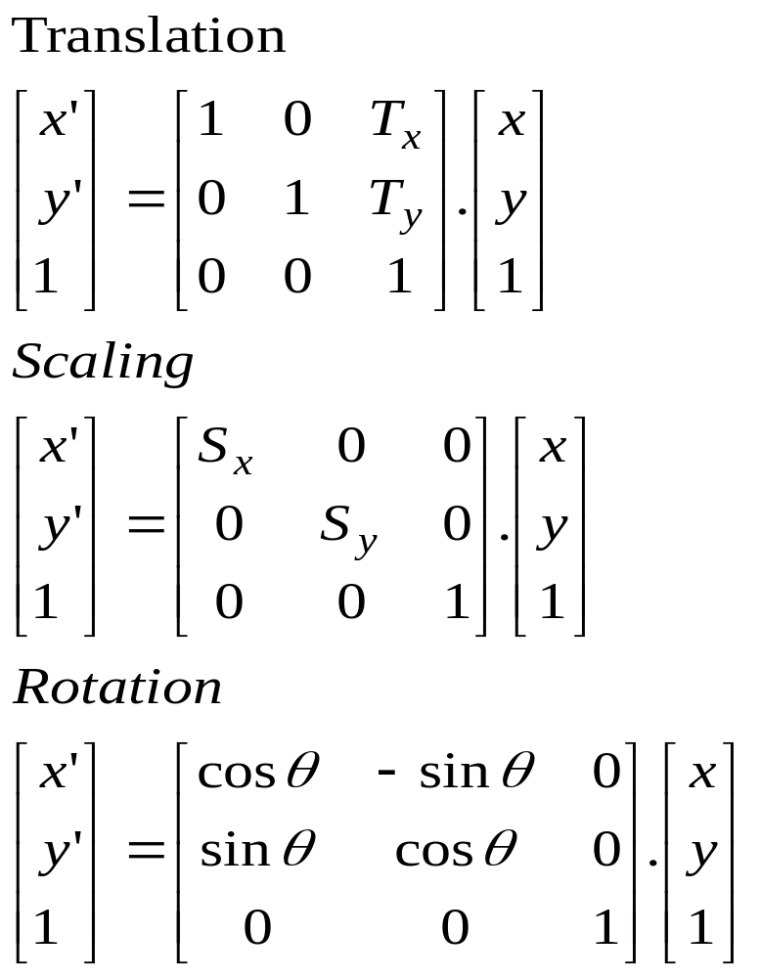
Contd…

Slide 4

Reflection
Produces a mirror image of an object
basic principles:
  the image of an object is formed on the side opposite to where the object is lying
  the perpendicular distance of reflected object from mirror line is identical to the original object from mirror line

Slide 5
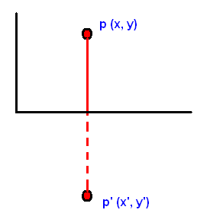
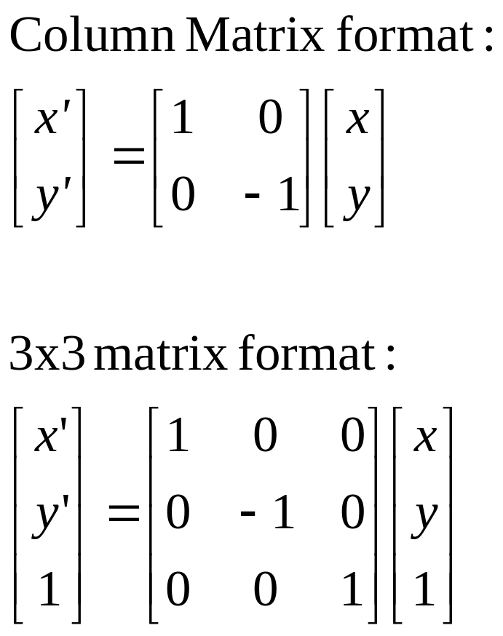
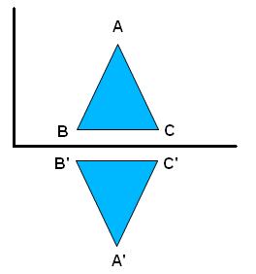
Reflection about x-axis
x’ = x and y’ = -y

Slide 6
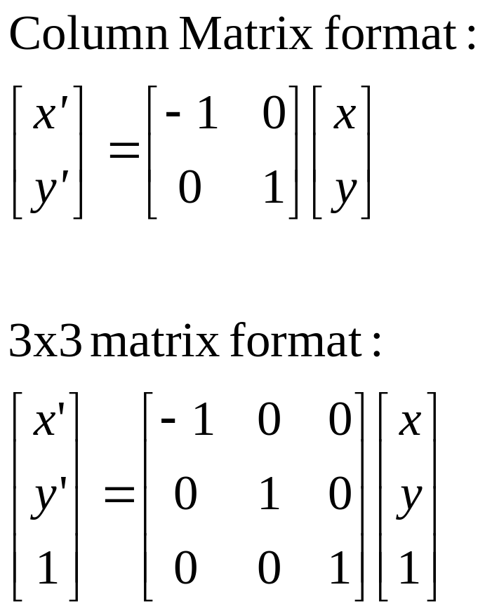
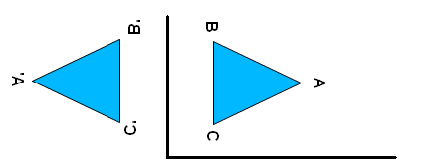
Reflection about y-axis
x’ = -x and y’ = y

Slide 7
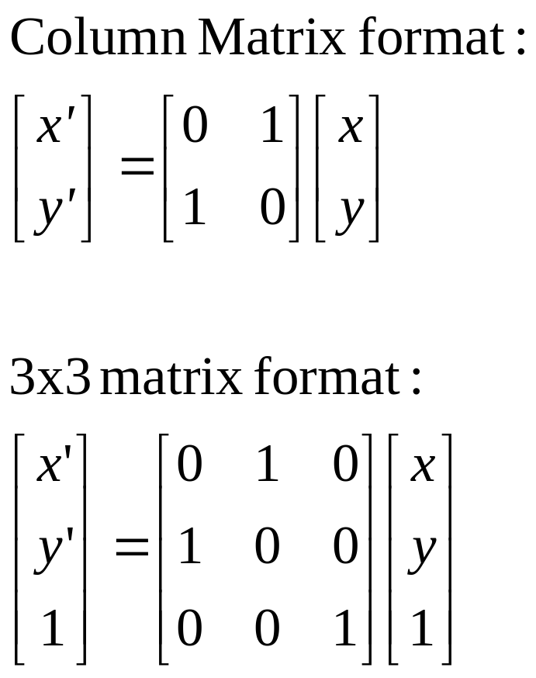
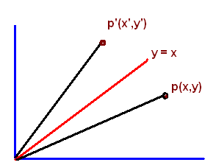
Reflection about y = x
x’ = y and y’ = x

Slide 8
Alternate method
rotate the object clockwise direction with an angle 45 degrees
reflection about x axis
rotate the object counter clockwise direction with an angle 45 degrees

Slide 9
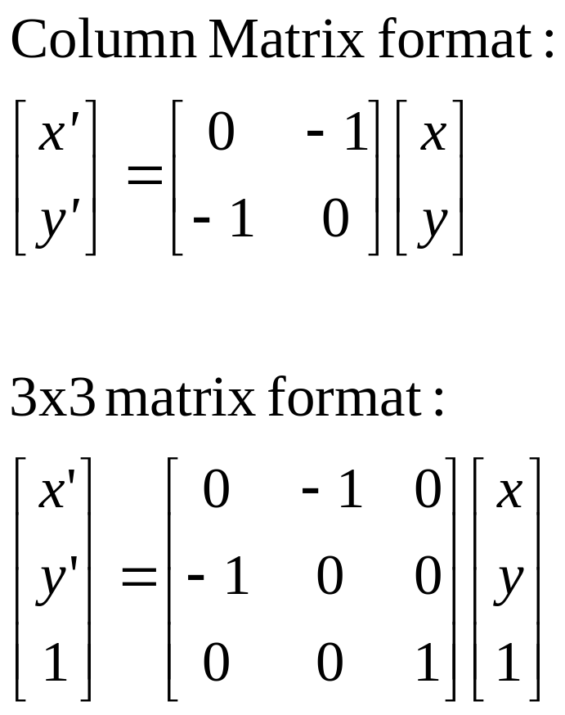
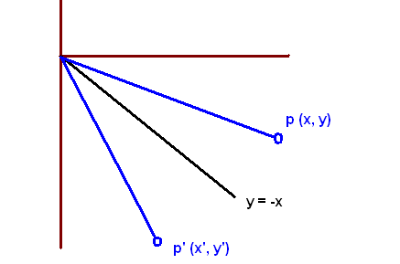
Reflection about y = -x
x’ = y and y’ = x

Slide 10
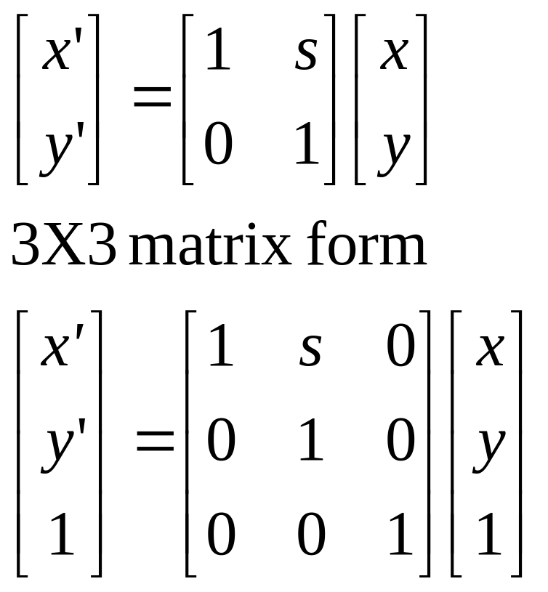
Shearing in x
Horizontal displacement proportional to vertical position

Slide 11

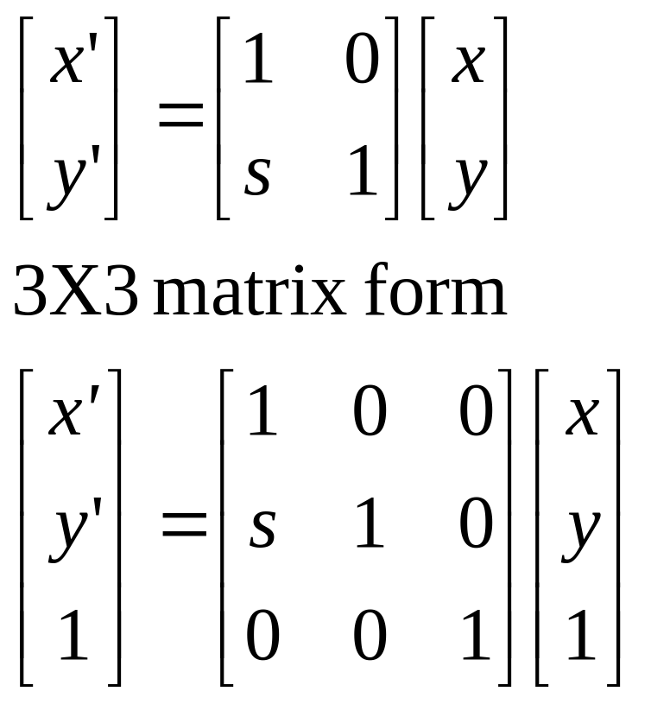
Shearing in y

Slide 12
Basic Primitive

Slide 13
Introduction
Output primitives : The basic building blocks for pictures
Attributes : properties of the output primitives
  Intensity and colour specifications
  Line styles
  Text styles
  Area filling properties
Geometric transformations
  Change the size, position, or orientation of an object
Modeling transformation :
  Used to construct a scene using object descriptions given in the modeling coordinates

Slide 14
Output Primitives
Raster Graphics Algorithms for Drawing 2D objects:
  Lines
  Circle
  Ellipse
  Parabola
  Hyperbola
  Polygon
  Filled Closed Objects

Slide 15
Line Drawing

Slide 16
Contd…
Draw a line on a raster screen between two points
What’s wrong with statement of problem?
  doesn’t say anything about which points are allowed as endpoints
  doesn’t give a clear meaning of “draw”
  doesn’t say what constitutes a “line” in raster world
  doesn’t say how to measure success of proposed algorithms

Slide 17
Contd…
Description: Given the specification for a straight line, find the collection of addressable pixels which most closely approximates this line.
Goals (not all of them are achievable with the discrete space of a raster device):
  Straight lines should appear straight.
  Lines should start and end accurately, matching endpoints with connecting lines.
  Lines should have constant brightness.
  Lines should be drawn as rapidly as possible.

Slide 18
Problem Statement
Given two points P and Q in XY plane, both with integer coordinates, determine which pixels on raster screen should be on in order to make picture of a unit-width line segment starting at P and ending at Q
3 cases
  Horizontal Line
  Vertical Line
  Diagonal Line

Slide 19
Contd…
  Horizontal Line: Draw pixel P and increment x coordinate value by 1 to get next pixel.
  Vertical Line: Draw pixel P and increment y coordinate value by 1 to get next pixel.
  Diagonal Line: Draw pixel P and increment both x and y coordinate by 1 to get next pixel.
Others create problems: stair-casing/ jaggies/ aliasing
Quality of the line drawn depends on the location of the pixels and their brightness

Slide 20
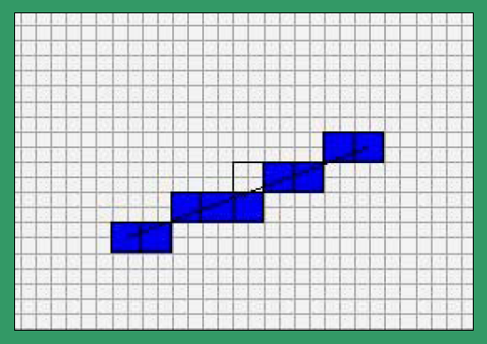
Contd…
It is difficult to determine whether a pixel belongs to an object

Slide 21
Line drawing algorithms
The Cartesian slope intercept equation for a straight line is
y = m . x + b
Where ‘m’ is the slope and ‘b’ is the y intercept
Basic Algorithm
  Find equation of line that connects two points P and Q
  Starting with leftmost point P, increment x_{i} by 1 to calculate y_{i} = mx_{i} + b
  where m = slope, b = y intercept
  Intensify pixel at (x_{i}, Round(y_{i})) where
  Round (y_{i}) = Floor (0.5 + y_{i})

Slide 22
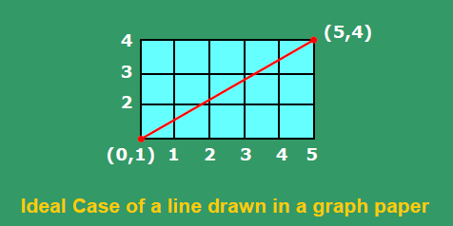
Example
Take an example,b = 1 and m = 3/5.
Then x = 1, y = round(8/5) = round (1.6)➔ 2
x = 2, y = round(11/5) = round (2.2) ➔ 2
x = 3, y = round(14/5) = round (2.8) ➔ 3
x = 4, y = round(17/5) = round (3.4) ➔ 3
x = 5, y = round(20/5) = round (4.0) ➔ 4

Slide 23
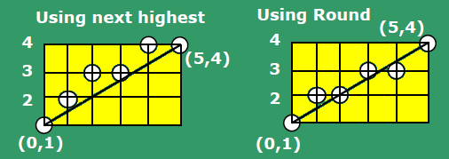

Slide 24
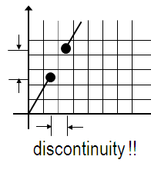
Drawbacks
`*´ and `/´ are expensive
Round() function needed
What if line slope > 1?
  More gaps in the line
Notes:
Example : y = 5.x + 2

Slide 25
The basic Incremental Algorithm
y_{i}= m . x_{i} + b
Y_{i+1}= m . x_{i+1} + b
Y_{i+1}= m . (x_{i} + Δx) + b
Y_{i+1}= y_{i} + m. Δx
If Δx = 1, then y_{i+1} = y_{i} + m
At each step, we make incremental calculations based on preceding step to find next y value

Slide 26
Contd…
Incremental technique avoids the need to deal with y intercept
If |m| >1, a step in x creates a step in y that is greater than 1. Thus, we must reverse the roles of x and y by assigning a unit step to y and incrementing x by Δx = Δy/m
This algorithm is also known as digital differential analyzer (DDA) algorithm as it traces out successive (x, y) values by simultaneously incrementing x and y by small steps proportional to the first derivative of x and y

Slide 27
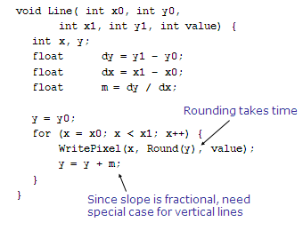
Problem with Incremental
Algorithm

Slide 28
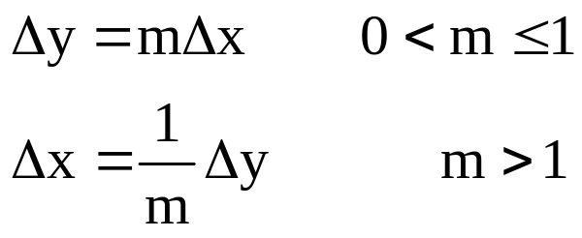
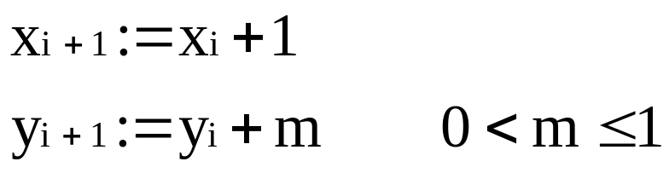
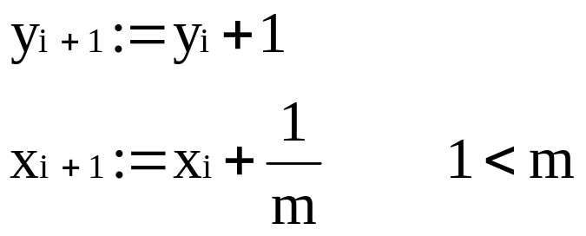
Summary
Basic idea
Take unit steps with one coordinate and calculate values for the other coordinate

